Slide 1




Part 1
Course: Vaccines
Virus cultivation for vaccine preparation
Lecturer: Dr. Gehad Elkady

Slide 2
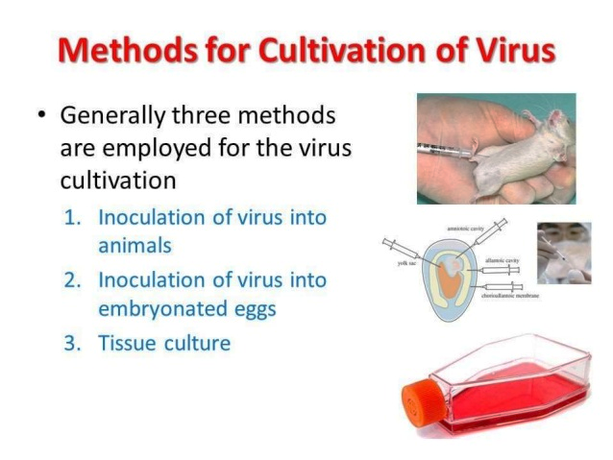
Methods for virus cultivation:
1. In (Specific Pathogen Free) SPF suceptible Laboratory animal.
2. In SPF suceptible fetrile ECE.
3. In SPF suceptible cell culture.
Categories of virus vaccines according to the used host:
1. Egg-based virus vaccine.
2. Cell culture-based virus vaccine.

Slide 3
1. Egg-based virus vaccine:
-Types of susceptible living cells inside the Fertile ECE:
1. CAM cells.
2. Allantoic cells.
3. Amniotic cells.
4. Yolk cells.

Slide 4
-Types of virus vaccines:
1.Live attenuated virus vaccine .
2. Inactivated virus vaccine .
3. Split (Subunit) virus vaccine.
1. Steps of preparation and purification of live attenuated virus vaccine:
-e.g. Influenza Virus (IV).
1.By a number of serial viral passages (by allantoic route) until disappear of the IV clinical signs. Then, propagation of such attenuated virus to achieve high titer of the attenuated virus to be used as a vaccine.
2. Collection of allantoic fluid at the end of the incubation period of the virus (the last serial passage).
3. Clarification of the cellular debris which contaminated to the virus, by centrifugation (5000xg/30mim/4º C).
4. Collection of the supernatant (virus+ the cellular debris different in the virus density), then perform density gradient centrifugation.

Slide 5
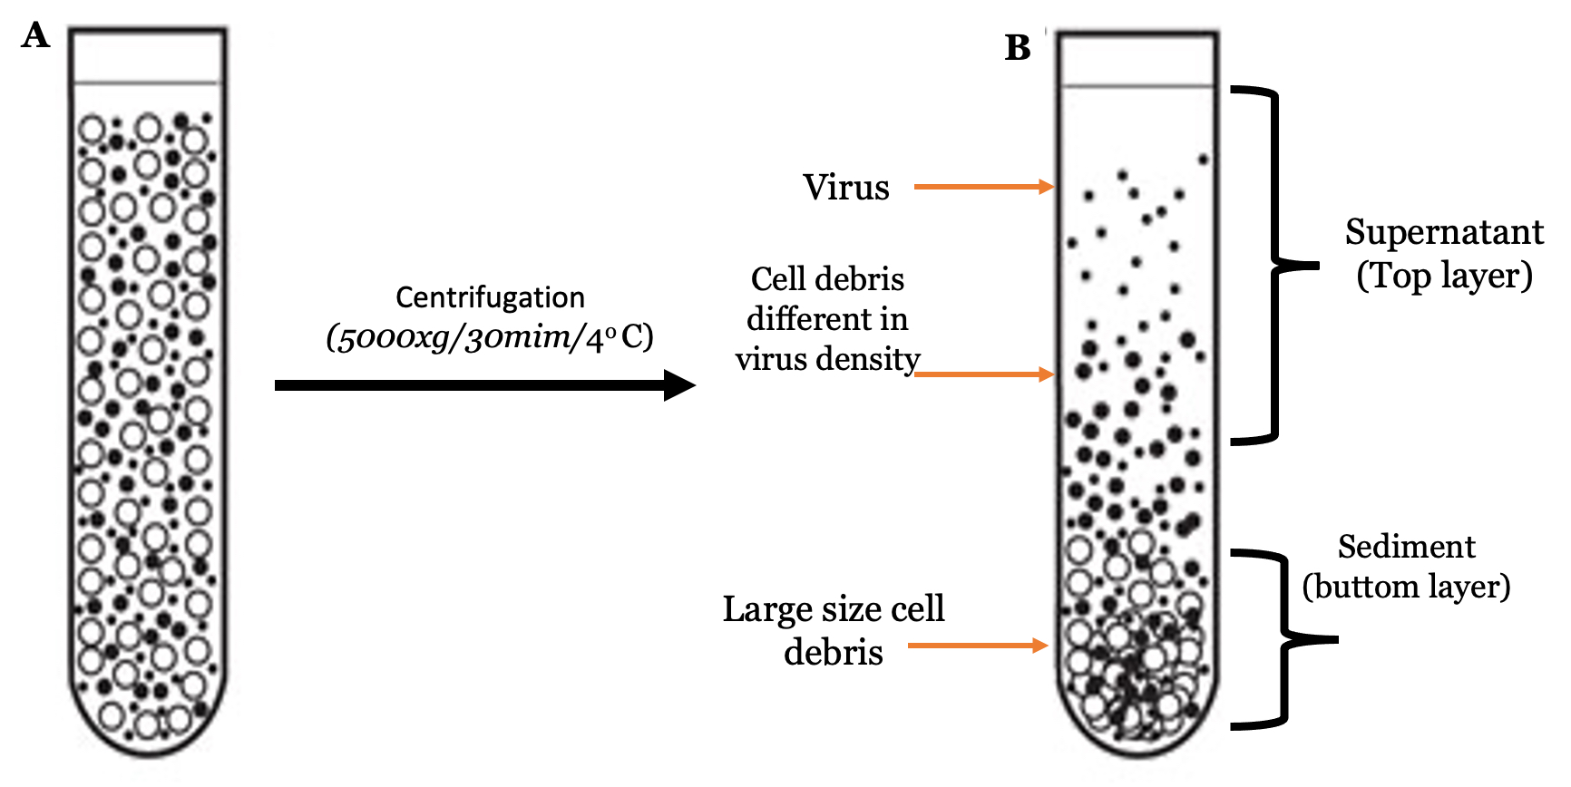

Slide 6
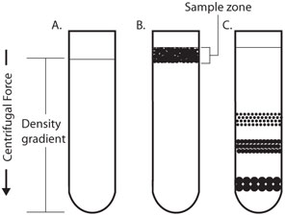
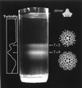
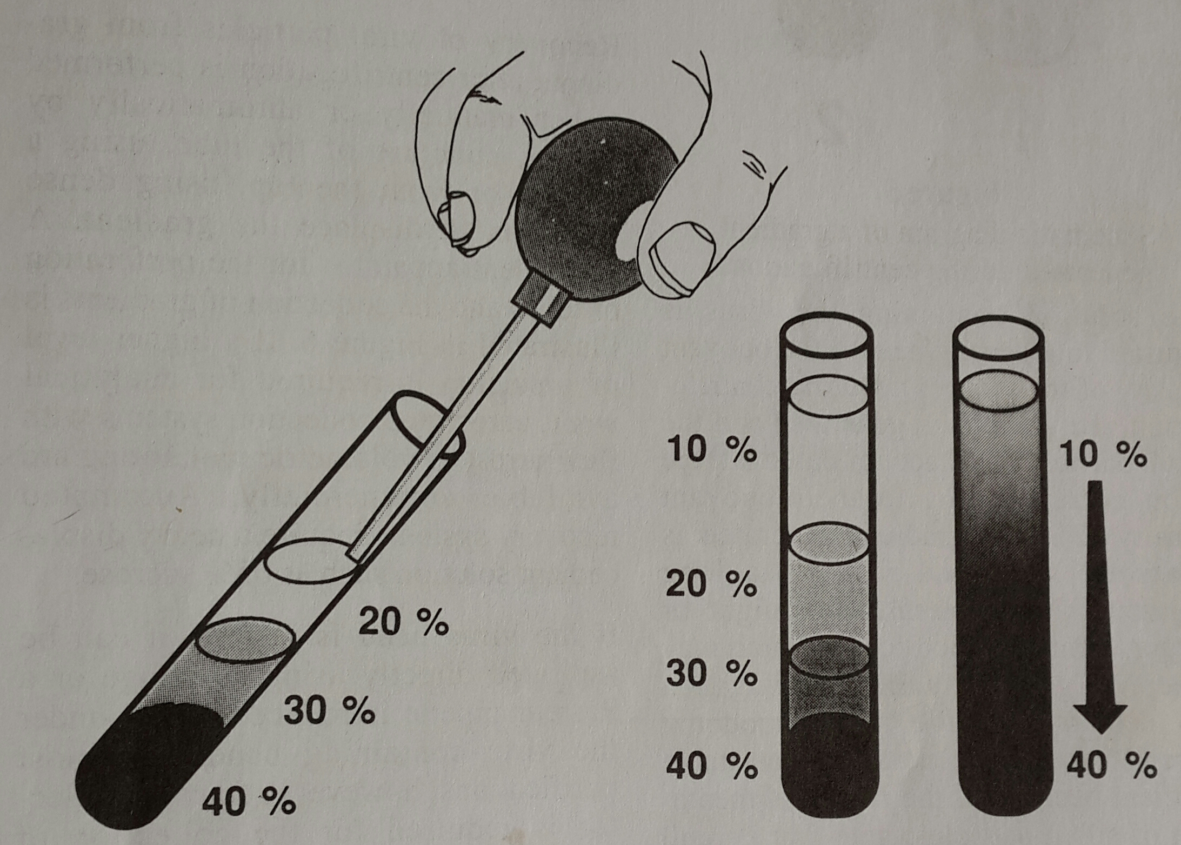
5. Density gradient centrifugation: depends upon the density of the particles: e.g. Sucrose density gradient centrifugation:
- Time and force: 20,000xg/20 min/4 º C.
- Each particles will reach the layer equal to its density.
- If the time and centrifugal force increased, the whole sample particles will be sedimented.
- The virus particles can be separated from the other particles similar to its density.
Supernatant
(Top layer)

Slide 7
6. Sterile filteration: by filter size (0.22µm or 0.45µm pore diameter).
2. Steps of preparation and purification of inactivated viral vaccine:
1-Attenuation as in live attenuated vaccine.
2.Purification as in live attenuated vaccine then addition of formaline.

Slide 8
Disadvantages of egg-based vaccine:
1. Presence of latent infection. E.g: Mycoplasma bacteria.
2. Presence of maternal antibodies.
3. Presence of endogenous vertical infection, e.g: salmonella and Marek’s disease virus.
2. Cell culture-based virus vaccine:
-Advantages of Cell culture-based virus vaccine:
1. We can obtain mass-vaccine production (thousands of liters of virus vaccine).
2. All of the steps of the vaccine production are automatic. So, low risk of contamination in relative to egg-based vaccine.
3. No need to manage biosecured chicken flocks.
4. Available anytime (because it can be preserved at Liquid Nitrogen Tank (LNT)).

Slide 9
Types of the cell culture:
1. Primary cells.
2. Diploid cells.
3. Transformed cell line.
Comparsion | Primary cells | Diploid cells | Transformed cell line
Confluency | + | + | +
Growth in Suspension | - | + | +
No. of subcultures | Definite No. | Definite No. higher than the primary | Indefinite No.
examples | CEF | MRC5,WI38 | Vero, MDCK, HEK293,BHK21
Genome Editing | - | - | Can be edited by CRISPR CAS9
Vaccine production |  |  | Prefered to be used for vaccine production

Slide 10
-Designed cell lines:
- It is genome edited cell line which can be used for viral vaccine production.
-Examples of designed cell lines:
1. EPR: Human embryonic retinoblast.
2. CAP: Human embryonic cells.
3. AGE1: Duck embryonic cells.
4. EB66: Duck embryonic stem cells.

Slide 11
Types of cell culture media:
1. Serum-based media.
2. Chemically synthetic serum-free media.
1. Serum-based media:
-Consists of: Cell Culture Media+Serum.
-Media (consists of :Buffer+salts+vitamins+amino acids+antioxidants) e.g. DMEM, F12, RPMI+Seum (e.g. Fetal calf serum).
-Disadvantages of Serum-based media:
1. It may contain specific antiviral antibodies.
2. It contains large amount of proteins with high concentrations, which not needed for growth of the cells.
3. Difficult to purify the viral vaccine protein from the seum protein.
2. Chemically synthetic serum-free media:
-Consists of: Cell Culture Media+(Synthetic albumin+ Synthetic lipid+ Synthetic enzymes+ Synthetic selenium+ Synthetic antioxidant+ Synthetic surfactant).
-advantages of Chemically synthetic serum-free media:
1. free from specific antiviral antibodies.
2. It contains specific amount of proteins with specific concentrations, which exactly needed for the growth of the cells.
3. Easy to purify the viral vaccine protein from the media.

Slide 12
-Production of cell-culture based viral vaccine:
-Mass-vaccine production in fermenter, by:
Microcarrier cell culture: which contains beads to provide large amount of space for cell growth, therfore, thousands liters of viral vaccine.

Slide 13
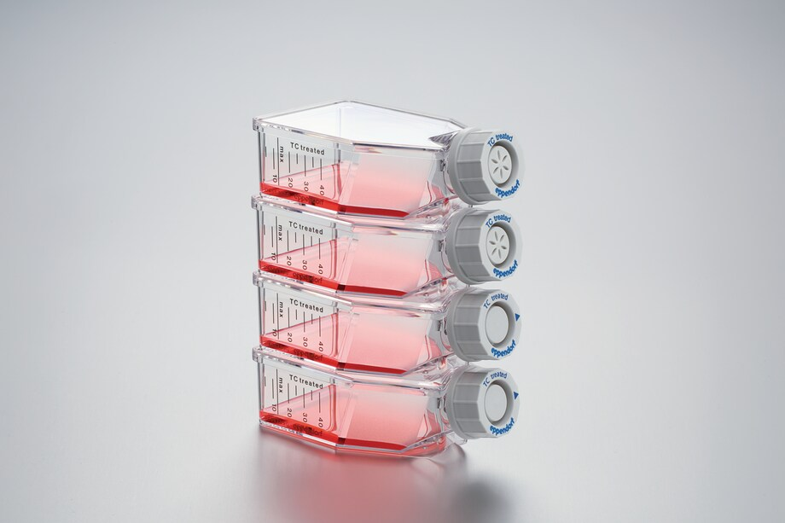
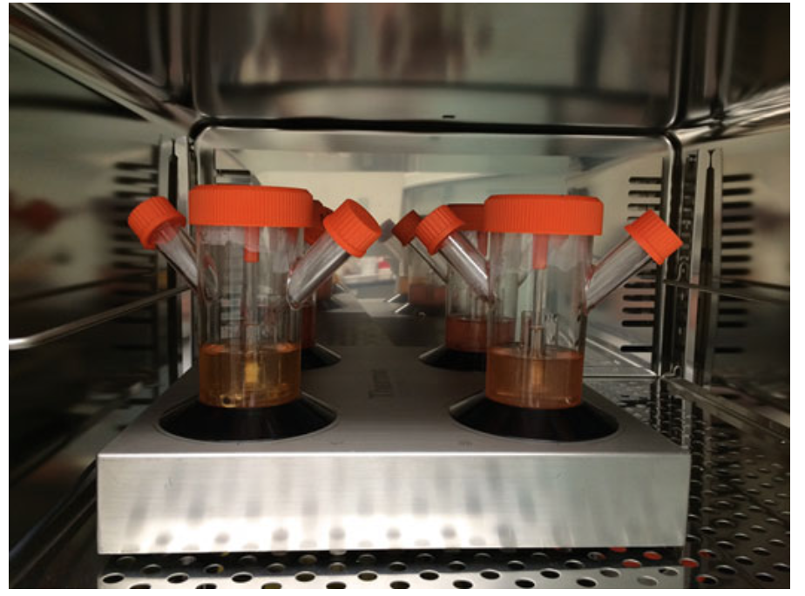
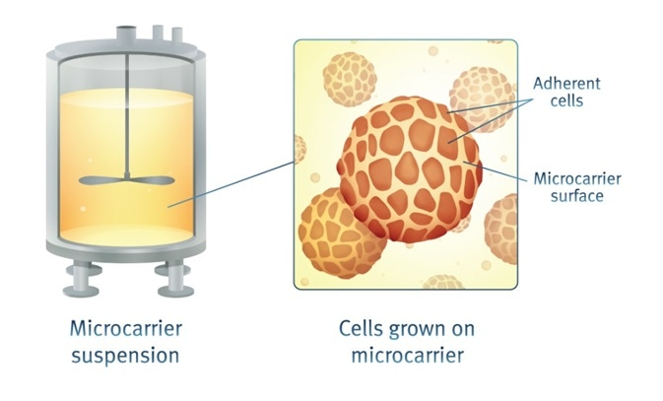
Confluent monolayer cells
Free cell suspension
Microcarrier suspension

